Slide 1
TensorCast: Forecasting with Context using Coupled Tensors
Literature review

Slide 2
Contents
1
Problem description
2
Major works
3
Experimental study

Slide 3

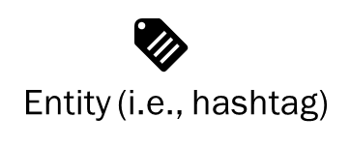


1 Problem description
Forecast social network
Time horizon
Time horizon
User-entity interaction
User-user interaction
Membership records
(N users, M topics, T intervals)
User interaction records
(N users, N users, T intervals)
$$𝓧∈{\{0,1\}}^{N×M×T}$$
$$𝓨∈{\{0,1\}}^{N×M×T}$$

Slide 4

1 Problem description
Forecast social network
Prediction
Time horizon
Time horizon
User-entity interaction
User-user interaction
Membership records
(N users, M topics, T intervals)
User interaction records
(N users, N users, T intervals)
$$𝓧∈{\{0,1\}}^{N×M×T}$$
$$𝓨∈{\{0,1\}}^{N×M×T}$$
S step user-entity interaction
Top K non-zero elements
$$\hat{𝓧}∈{\{0,1\}}^{N×M×S}$$

Slide 5
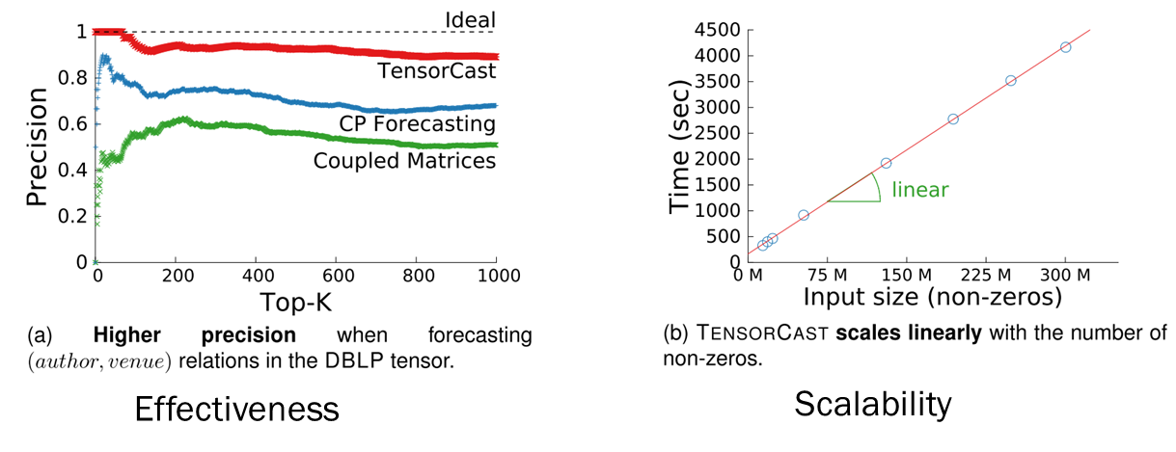
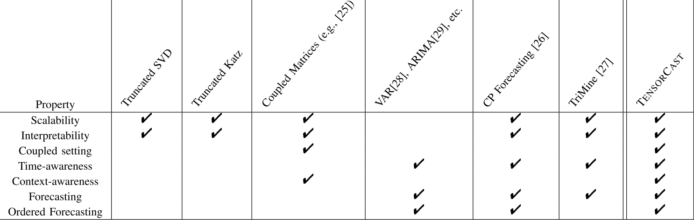
2 Major works
Contributions

Slide 6
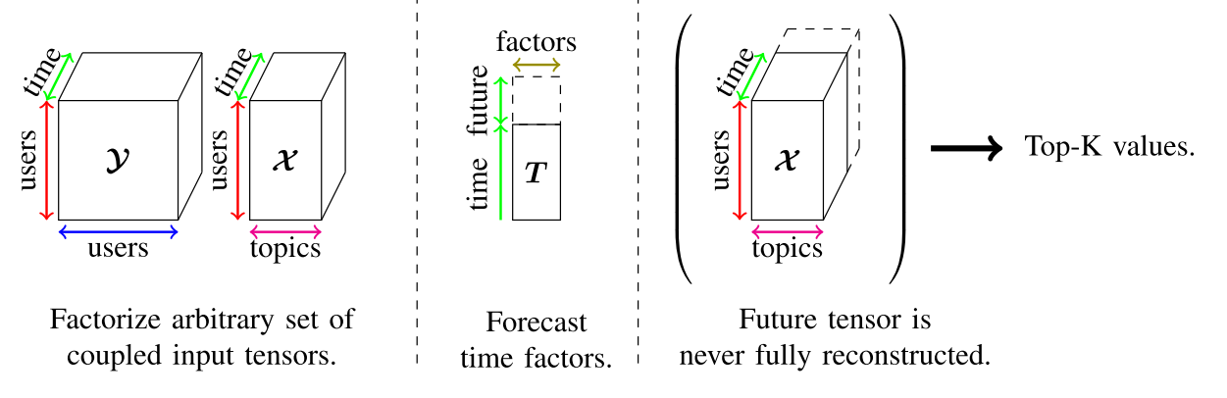
2 Major works
Methodology
Non-negative Coupled Factorization
Factorization will tie together the various input tensors and identify their rank-1 components.
Forecasting
Given the low dimensional space identified, use standard techniques to forecast the time component.
Tensor Top-K elements
Exploit the factorization structure and identify the top elements without considering the big future tensor.

Slide 7

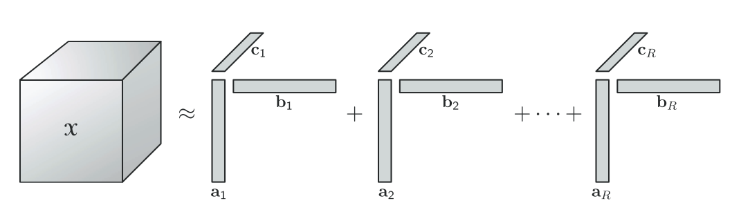
2 Major works
Methodology Non-negative Coupled Factorization
CP decomposition

Slide 8

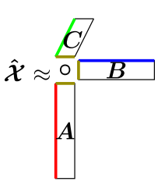
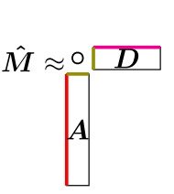
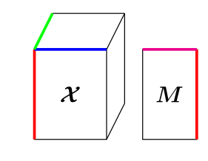
2 Major works
Methodology Non-negative Coupled Factorization
CP decomposition
Matrix-tensor factorization

Slide 9

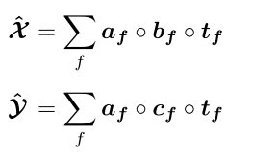




2 Major works
Methodology Non-negative Coupled Factorization
CP decomposition
Matrix-tensor factorization
Coupled tensor -tensor factorization
$$𝓧$$
$$+…$$
$$𝓨$$
$$+…$$

Slide 10
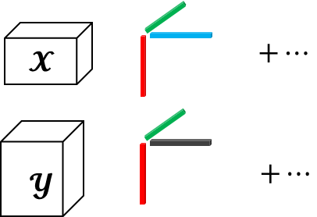
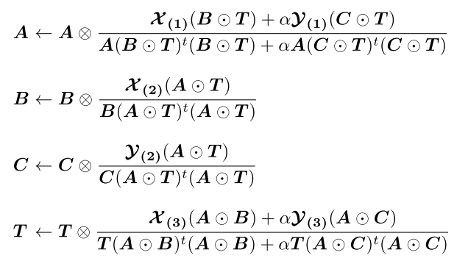
2 Major works
Methodology Non-negative Coupled Factorization
Coupled tensor -tensor factorization

Slide 11
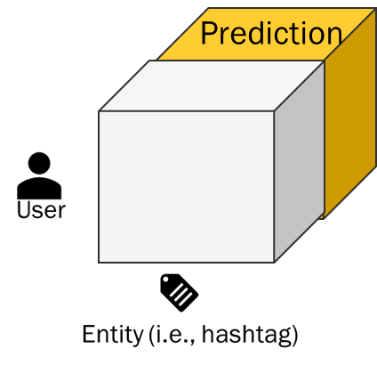
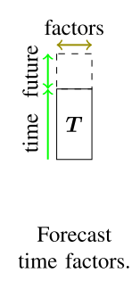


2 Major works
Methodology Forecasting
$$+…$$
Factor prediction
Exponential smoothing…

Slide 12
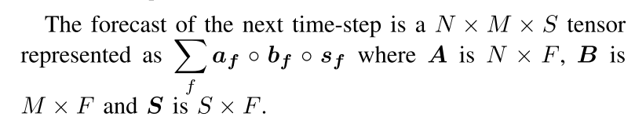
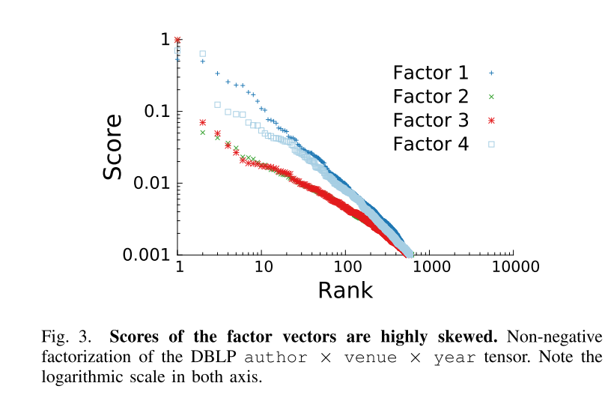
2 Major works
Methodology Tensor Top-K elements
Identity K（i,j,k）positions with highest value based on the latent factors
Notes:
background

Slide 13
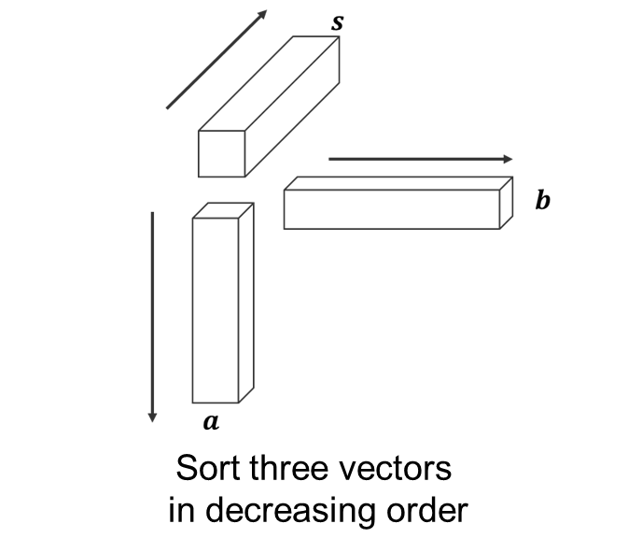




2 Major works
Methodology Tensor Top-K elements
Single factor
Maintain
a
priority
queue
Dequeue
$$a_{1}b_{1}s_{1}$$
Backup
$$a_{2}b_{1}s_{1}$$
$$a_{1}b_{2}s_{1}$$
$$a_{1}b_{1}s_{2}$$

Slide 14
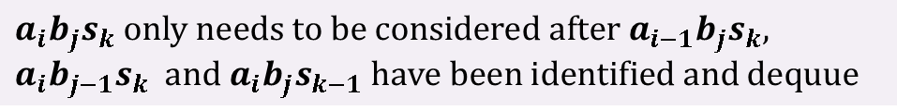
2 Major works
Methodology Tensor Top-K elements
Single factor
Maintain
a
priority
queue
Dequeue
$$a_{1}b_{1}s_{1}$$
Backup
$$a_{2}b_{1}s_{1}$$
$$a_{1}b_{2}s_{1}$$
$$a_{1}b_{1}s_{2}$$
Sift
$a_{i}b_{j}s_{k} only needs to be considered after a_{i−1}b_{j}s_{k}, {a_{i}b_{j−1}s_{k} and a}_{i}b_{j}s_{k−1} have been identified and dequue$

Slide 15



















2 Major works
Methodology Tensor Top-K elements
Single factor
Maintain
a
priority
queue
Dequeue
$$a_{1}b_{1}s_{1}$$
Backup
$$a_{2}b_{1}s_{1}$$
$$a_{1}b_{2}s_{1}$$
$$a_{1}b_{1}s_{2}$$
Sift
$$a_{2}b_{1}s_{1}$$
$$a_{1}b_{2}s_{1}$$
$$a_{1}b_{1}s_{2}$$
Dequeue
$$a_{2}b_{1}s_{1}$$
$$a_{1}b_{2}s_{1}$$
$$a_{1}b_{1}s_{2}$$
Backup
$$a_{3}b_{1}s_{1}$$
$$a_{1}b_{2}s_{1}$$
$$a_{1}b_{1}s_{2}$$
$${a_{2}b}_{2}s_{1}$$
$${a_{2}b}_{1}s_{2}$$
Sift
$$a_{3}b_{1}s_{1}$$
$$a_{1}b_{2}s_{1}$$
$$a_{1}b_{1}s_{2}$$
$$⋮$$

Slide 16
2 Major works
Methodology Tensor Top-K elements
Multiple factors

Slide 17




2 Major works
Methodology Tensor Top-K elements
Multiple factors
$$⋯$$
$${(a_{1}b_{1}s_{1})}^{(1)}$$
$${(a_{1}b_{1}s_{1})}^{(2)}$$
First element of each priority queue
$${(a_{1}b_{1}s_{1})}^{(3)}$$

Slide 18
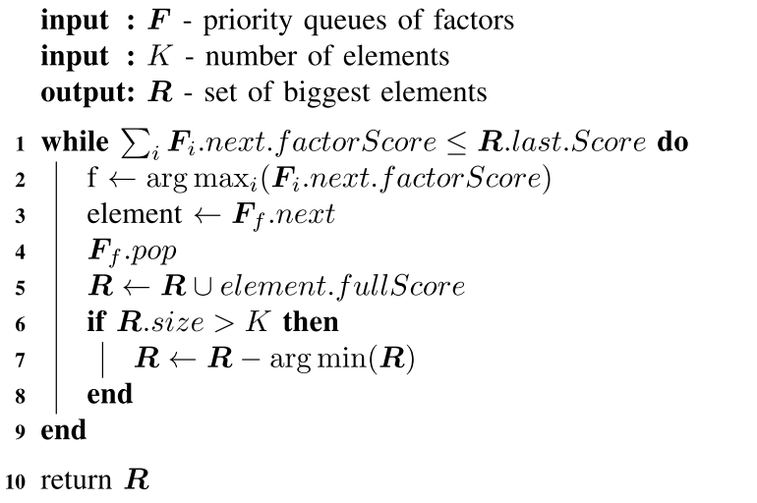
2 Major works
Methodology Tensor Top-K elements
Multiple factors

Slide 19
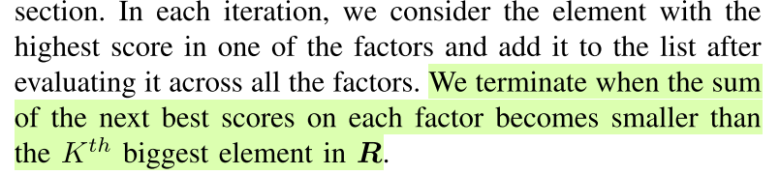

2 Major works
Methodology Tensor Top-K elements
Multiple factors
Should be $≥$

Slide 20
2 Major works
Methodology Tensor Top-K elements
Multiple factors
Prove the correctness and upper bound on the overall number of elements that need to be evaluated.

Slide 21
2 Major works
Methodology Tensor Top-K elements
Multiple factors
Prove the correctness and upper bound on the overall number of elements that need to be evaluated.
Correctness – Smallest element in output is larger than the maximum sum from left elements in each priority queue.

Slide 22
2 Major works
Methodology Tensor Top-K elements
Multiple factors
Prove the correctness and upper bound on the overall number of elements that need to be evaluated.
Correctness – Smallest element in output is larger than the maximum sum from left elements in each priority queue.
Upper bound – The set of elements that need to be considered is small when factors follow common power-law distributions.

Slide 23
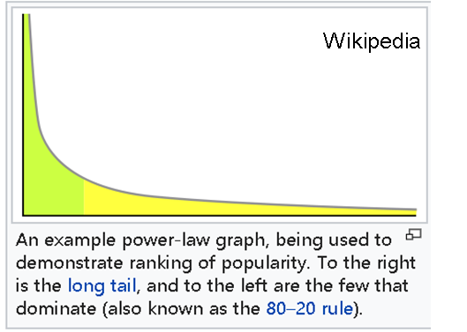




2 Major works
Methodology Tensor Top-K elements
Multiple factors
Prove the correctness and upper bound on the overall number of elements that need to be evaluated.
Correctness – Smallest element in output is larger than the maximum sum from left elements in each priority queue.
Upper bound – The set of elements that need to be considered is small when factors follow common power-law distributions.
$$b$$
$$a$$
$$p\left(x\right)=(α−1)x^{−α}$$
$$a°b$$
Factor follows power-low distribution, then the frontal slice also follows power-low distribution

Slide 24



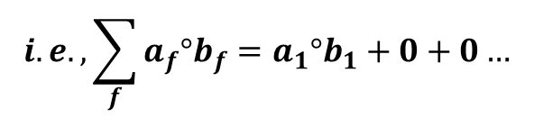
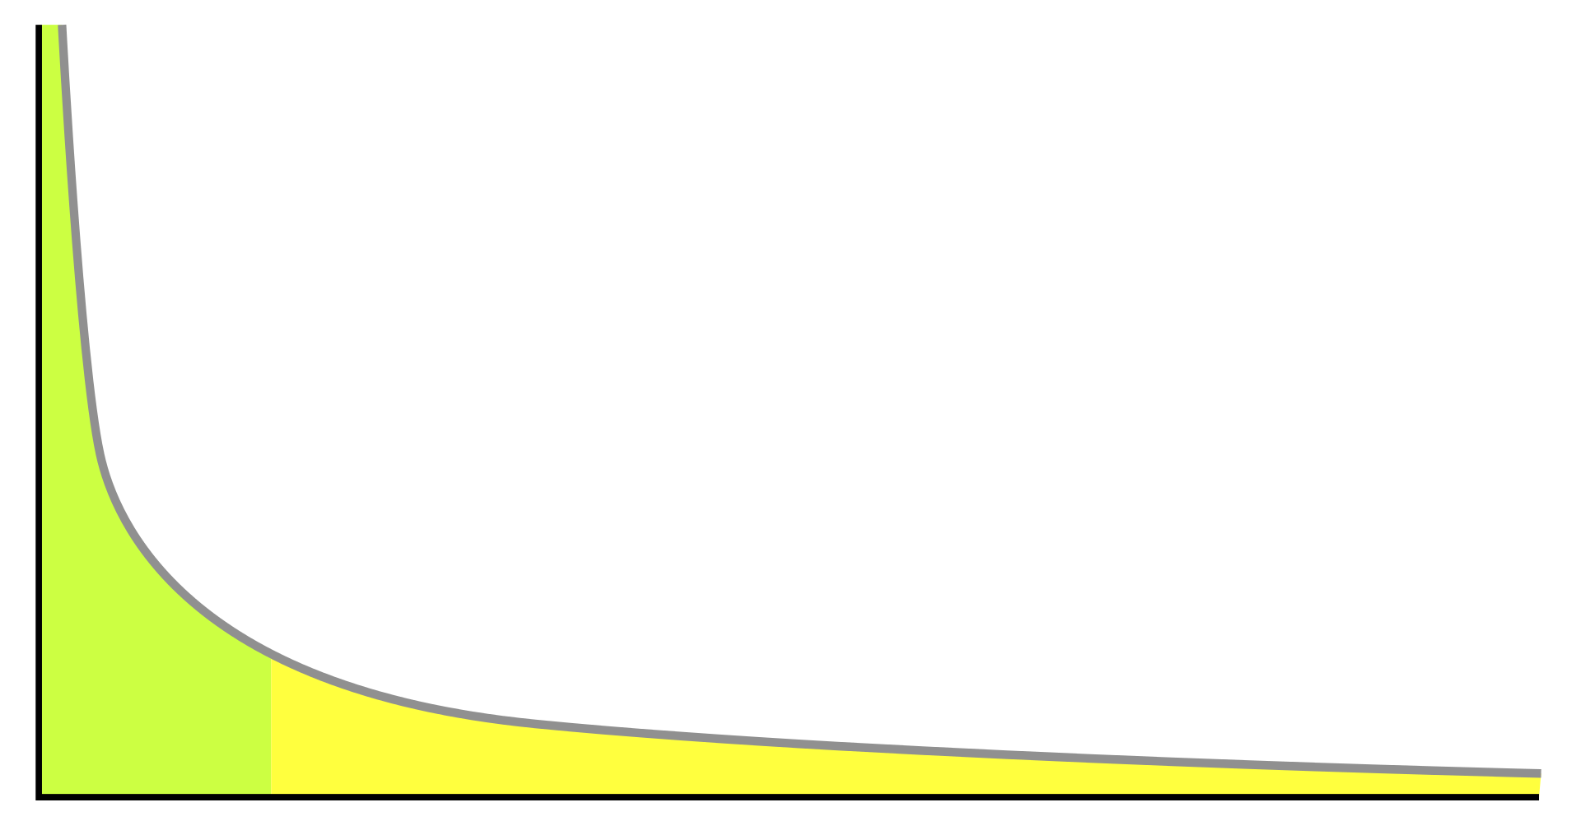




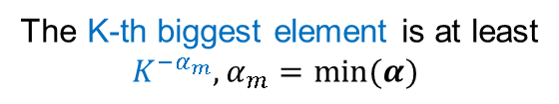


2 Major works
Methodology Tensor Top-K elements
Multiple factors
$$b$$
$$\sum_{f}{a_{f}°b_{f}}$$
$$a$$
$$a°b$$
The K-th biggest element is at least
$K^{−α_{m}},α_{m}=min⁡(α)$
$$K^{−α_{m}}$$
$$K$$

Slide 25
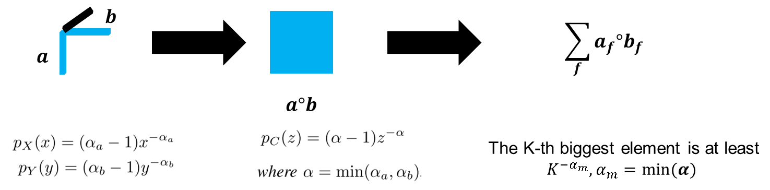


2 Major works
Methodology Tensor Top-K elements
Multiple factors
Upper bound to find K-biggest elements of the frontal slice is based on aforementioned elements in at least one of the factors, the worst case is in each factors :

Slide 26
3 Empirical study
Dataset
DBLP
Twitter
Time horizon
Prediction 2015
authors
authors
Co-authorship
Time horizon
1970-2014
venues
authors
Prediction week51
Time horizon
users
users
Time horizon
2019-6 – 2019-12
Re-tweet
hashtag
users

Slide 27
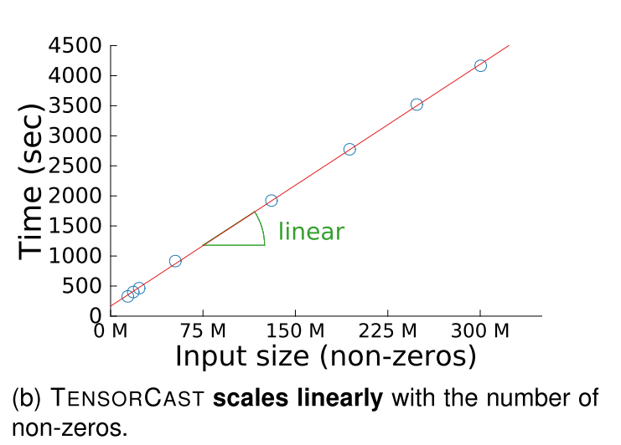
3 Empirical study
Scalability
Twitter dataset
* Create a sequence of pairs of tensors that increase in size by changing the number of weeks under consideration

Slide 28
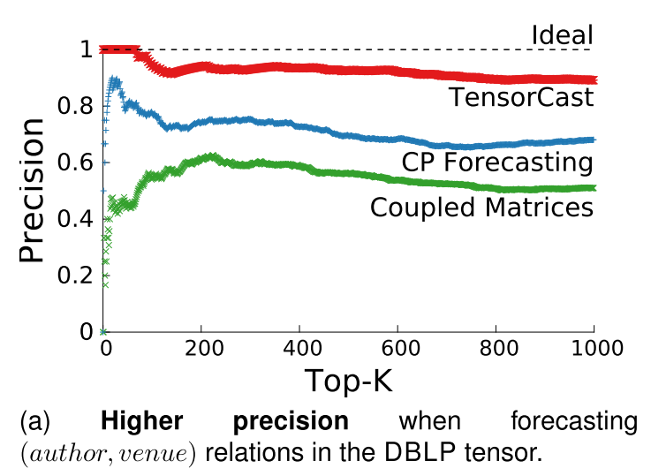
3 Empirical study
Effectiveness and contextual awareness
DBLP dataset
* In top-K accuracy you give yourself credit for having the right answer if the right answer appears in your top K guesses.

Slide 29
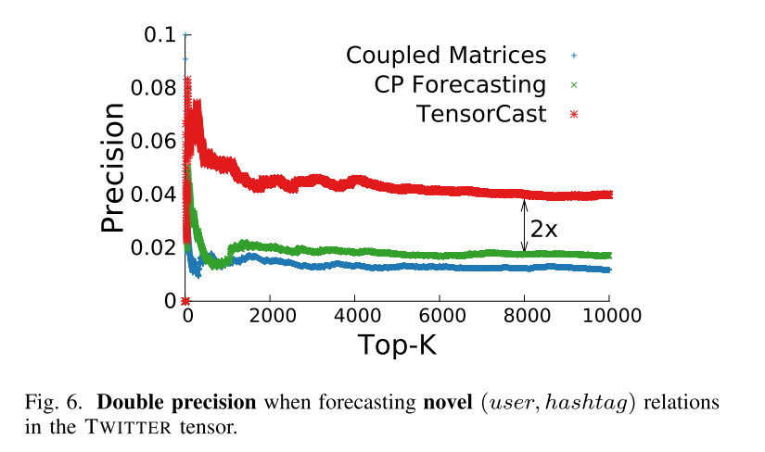
3 Empirical study
Effectiveness and contextual awareness
Twitter dataset

Slide 30
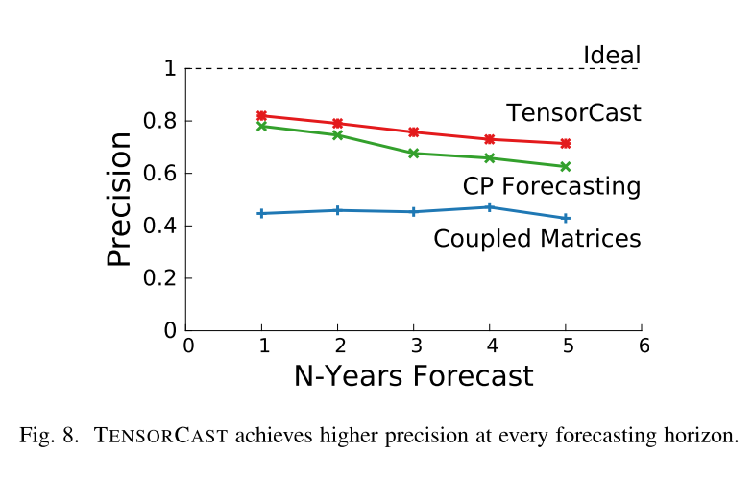
3 Empirical study
Precisions over time
DBLP dataset

Slide 31
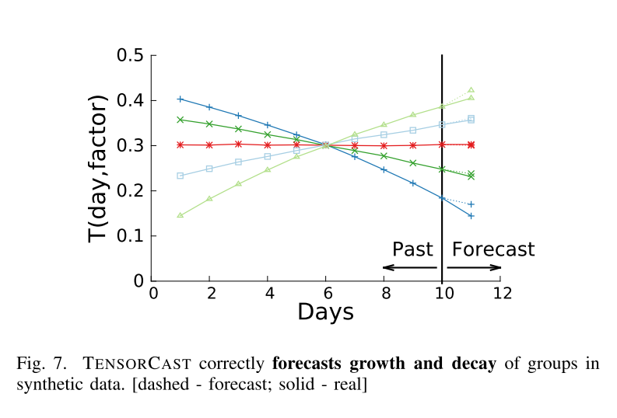
3 Empirical study
Trend Following
Synthetic dataset with 5 hyperbolic communities (groups)
Average (interaction) density of 5 groups is the same, but the trend varies(+1%,+2%,0,-1%,-2%).
* Scores of the columns of the T matrix after factorization, one per line
* Linear changes in density correspond to linear changes of the scores and that TENSORCAST correctly forecasts a similar change in the future.

Slide 32
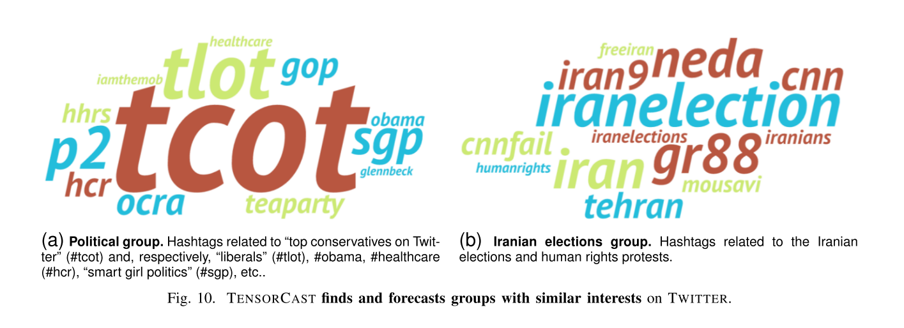
3 Empirical study
Discoveries
Twitter dataset
The importance of factor corresponds to the hashtag size
The larger hashtag matches the interests of the identified people.
Notes:
groups found by
TENSORCAST are interpretable due to the non-negativeness of the factors. We

Slide 33
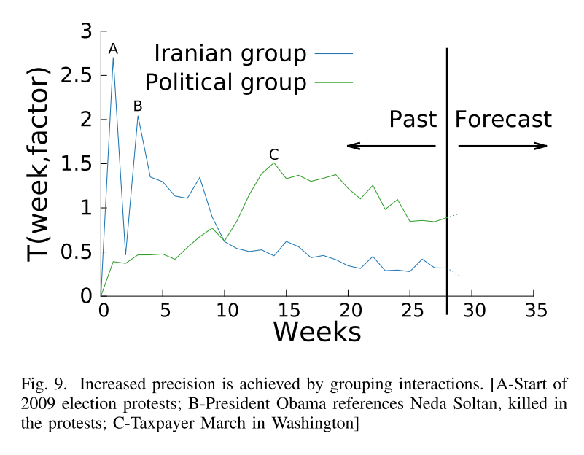
3 Empirical study
Discoveries
Twitter dataset
Time factor reflects the group interest on corresponding event.
Notes:
groups found by
TENSORCAST are interpretable due to the non-negativeness of the factors. We

Slide 34
Thank you for watching !

